Slide 1
Software Requirement Engineering Lecture 9

Slide 2
Team Skill 2: Understanding User and Stakeholder Needs Requirements Elicitation Techniques - I

Slide 3
Presentation Outline
The Challenge of Requirement Elicitation
Yes But Syndrome
Undiscovered Ruins
User and Developer Syndrome
Requirement Elicitation
The Requirement Elicitation Process
Requirement Elicitation Techniques
Interviews
Questionnaires
Background Reading

Slide 4
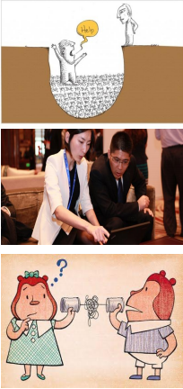

The Challenge of Requirements Elicitation
Requirements elicitation is complicated by three endemic syndromes.
The "Yes, But" syndrome
It has been observed that the users' reactions after checking software for the first time are: "Wow, this is so cool; we can really use this, and so on ….. "Yes, but, hmmmm, now that I see it, what about this . . . ? Wouldn't it be nice if . . . ? And so on . . . ”
The "Undiscovered Ruins” Syndrome
In many ways, the search for requirements is like a search for undiscovered ruins: the more you find, the more you know remain.
The "User and the Developer" syndrome
The third syndrome arises from the communication gap between the user and the developer .

Slide 5
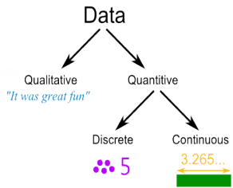
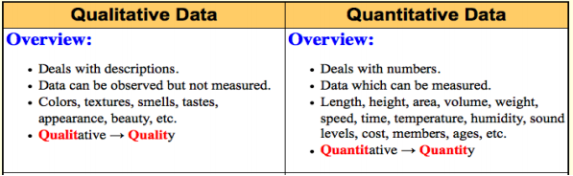
Methods of Collecting Data
Qualitative Data and Quantitative Data
Qualitative data is data that is mainly words, sounds or images.
Quantitative data is data that is mainly numbers.

Slide 6
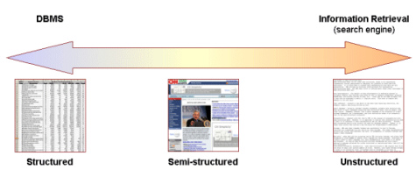
Methods of Collecting Data
Structured and Unstructured Data
Structured data is organized, unstructured data is relatively disorganized.
Structured data can be produced by closed questions, unstructured data can be produced by open questions.

Slide 7
Requirements Elicitation Techniques
Interviews
Questionnaires
Background Reading
Introspection
Social Analysis
Requirements Workshops
Brainstorming and Idea Reduction
Story Boarding
Role Playing
Prototyping
Requirements Reuse

Slide 8


Interviews [1]
One of the most important, popular, and most commonly used requirements gathering techniques is the user interview
A simple, direct technique that can be used in virtually every situation.
In this method the requirement engineering analyst’s discuss with different types of the stakeholders to understand the requirements of the system
There are two main types of interviews:
Closed Interviews
Open Interviews

Slide 9
Interviews
Closed Interviews
In closed interviews the requirements engineer prepares some predefined questions and he tries to get the answers for these questions from the stakeholder’s
Open Interviews
In open interviews the requirements engineer does not prepares any predefined questions and he tries to get the information from the stakeholder’s in open discussions
Closed ended Question
A close-ended question is one that demands mostly a brief yes or no response. [3,4]
Open ended Question
An open-ended question is one that demands far more than a brief yes or no response. [3,4]

Slide 10
Interviews [1]
Generally the interviews start wit predefined questions
However in the process of interview a lot of different considerable things may arise that leads to open discussion
Interviews are effective for understanding the problem in the existing system and to find the requirements of the stakeholders
To make the interview session effective the requirements engineer and the stakeholders has to perform in the following ways:
Interviewer should be patient enough to listen the stakeholder’s views and the requirements, he should be open minded
Stakeholders should be expressive in the interview session, they should express their views in definite context

Slide 11

The Interview Context [1]
Establishing the user profile
Assessing the Problem
Understanding the user environment
Recap for understanding
Analyst’s inputs on user’s problem
Assessing your Solution
Assessing the Opportunity
Assessing Reliability, Performance and Support needs
Any other requirements
Wrap up
Analyst’s Summary

Slide 12
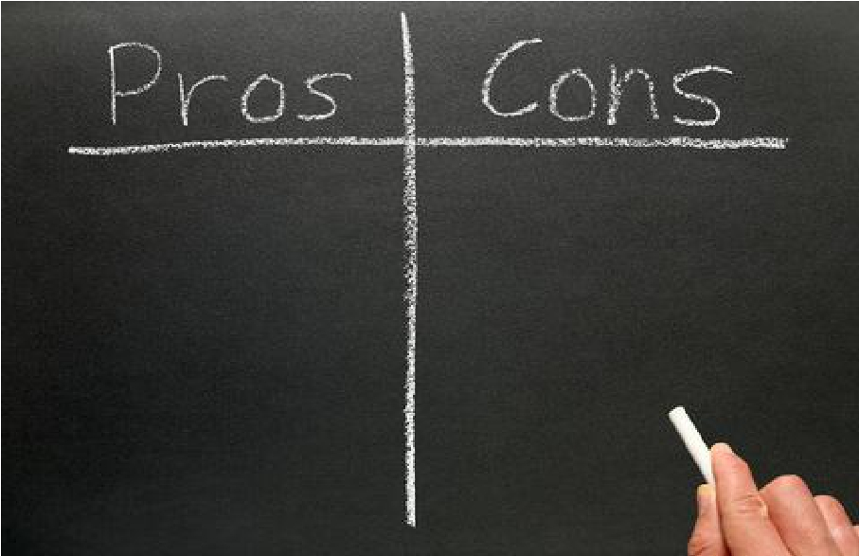
Interviews [1]
Rich collection of information
Uncovers opinions, feelings,
goals, as well as hard facts
Can probe in depth, and adapt follow-up questions to what the
person tells you
Large amount of qualitative data can
be hard to analyze
Not as many people from various parts of the company are interviewed, because of cost so there exists high possibility for bias
Usually many follow ups are required
for clarification
Interviewing is a difficult skill to master

Slide 13

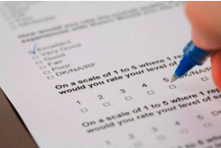
Questionnaires[1]
Questionnaires are one of the methods of gathering requirements in less cost and reach a large number of people only in lesser time
Can be manual (paper form) or electronic (soft form distributed through e-mail)
The results extracted from the Questionnaires must be clearly analyzed
The results from the Questionnaires mainly depends on the two factors::
Effectiveness and the design of Questionnaires
Honesty of the respondents
A well designed and effective questionnaire can be used to decide the actual user requirements, objectives and the constraints
A good structured questionnaire influences people to answer honestly thus making it possible to gather reliable results from the large group of people

Slide 14

The Designing of Questionnaires
The steps involved in designing and conducting the Questionnaires are::
The purpose of survey should be clearly defined
The Sampling group (respondents of the survey) should be decided
Clearly state Why the respondent was selected for questionnaire
Provide clear instructions on how to complete the questionnaire
Avoid asking two questions in one
Do not ask questions that give clues to answers
Keep the questionnaire brief and user friendly
Preparing and developing the questionnaire
Conducting the questionnaire process
Gathering and analyzing the results

Slide 15

The Designing of Questionnaires
The Designing of Questionnaire is a multi stage process and should be viewed accordingly
Assume 30-50% return rate for paper and email questionnaires
Assume a 5-30% return rate for web-based questionnaires

Slide 16
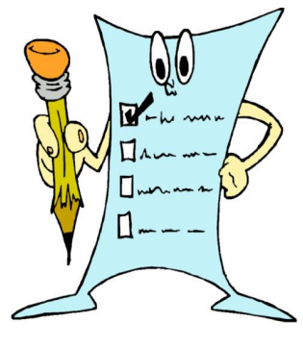
The Arrangement of Questionnaires
The steps in arranging a Questionnaire are::
The questions should be arranged well, so that general questions are followed by the particular questions
Arrange the questions such that easy questions come first
The questions relevant to the main subject should be given high priority

Slide 17

Questionnaires
A cheaper way to get feedback
from the users, because it can
reach to a large number of
users in a short period of time
They are easier to analyze
than interviews, because they
consist of multiple choice or
True & False questions
It is hard to create questionnaires
that will give all possible answer
options customer wants to give
There is always a high risk of
question ambiguity
Usually many follow ups are
required for regular feedback,
subsequently adding to the cost

Slide 18


Background Reading
Background Reading technique is used to gather information about the organization, which is helpful to gain an understanding of the organization’s structure and their working, and the existing system
Background Reading technique is not solely used for eliciting requirements because you can not get the real user needs by just studying the existing documents
It is used as a complementary approach with other techniques
Sources of information:
company reports, organization charts, policy manuals,
job descriptions, reports, documentation of existing systems, etc.
Appropriate for
when you are not familiar with the organization being investigated.

Slide 19
Background Reading
Analyst gets an understanding
of the organization before meeting
the people who work there.
Helps analysts to prepare for
other types of fact finding e.g.
Helps to prepare questions for
interviews and questionnaires
May provide detailed requirements for the current system.
Written documents often do not
match up to reality
Can be long-winded with much
irrelevant detail
This technique can not solely be
used for gathering requirements
because of absence of user
involvement

Slide 20
References
Managing Software Requirements: A Use Case Approach, Second Edition By Dean Leffingwell, Don Widrig, Addison- Wesley
http://www.redstarresume.com/content/cms/OpenEnded+and+ClosedEnded+Job+Interview+Questions/3525/
http://blog.simplyhired.co.uk/2011/07/open-vs-closed-tips-for -answering-theseinterview-questions.html
http://examples.yourdictionary .com/examples/examples-of-open-ended-and-closedended-questions.html

Slide 21


For any query Feel Free to ask

